Slide 1


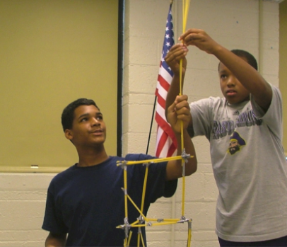
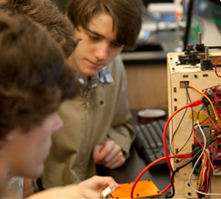
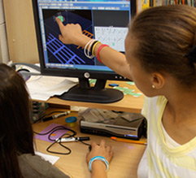

Expanding Our Horizons
Summary of Feedback from Our Community Conversations
School Board Retreat - June 3, 2013

Slide 2
History of Strategic Plan
2004-05
Original Vision, Mission, Goals, Values
2009-10
Limited Focus Group Review
Spring 2013
Comprehensive Review using Community Conversations

Slide 3
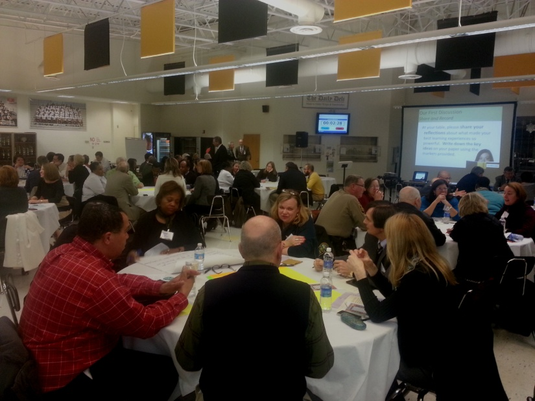
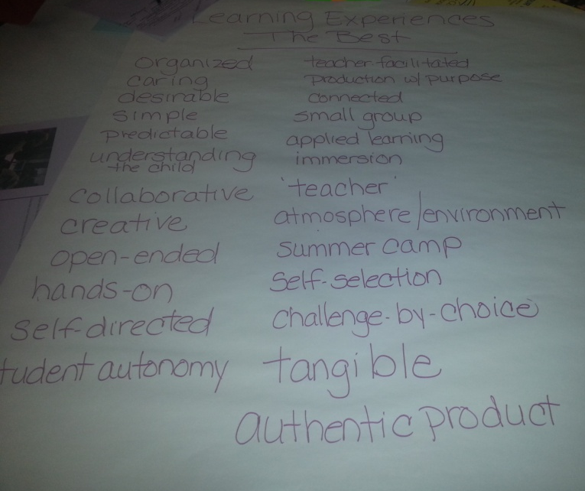
Our 2013 Review
Kick-Off Event
5 Town Hall Meetings
Focus Group Meetings
Advisory Group Meetings
Classroom Visits
Community Survey
Student Surveys

Slide 4
We heard from…
Students
Higher Education
Parents
Community Conversations
Legislative Aides
Teachers & Administrators
Community and Business Leaders
Classified Staff

Slide 5
Our 4 Questions
What was your favorite learning experience, and why?
What will the world be like in 20 years?
What skills will students need to be successful in the world of the future?
What should teaching and learning look like in ACPS to prepare our students for the future?

Slide 6

We asked people to…
  Be creative. Have fun. Doodle. Tweet. Dream. Explore.

Slide 7
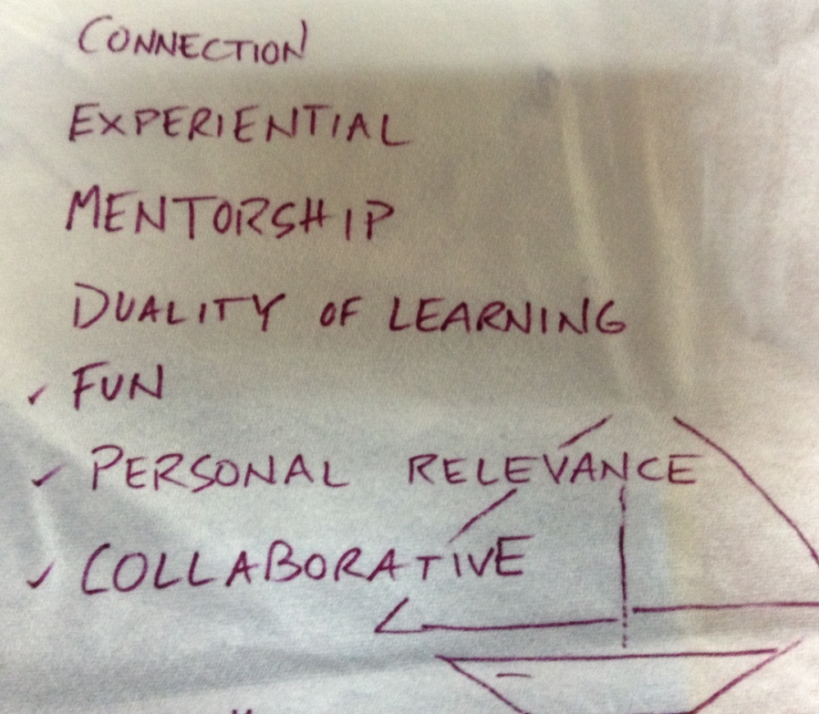

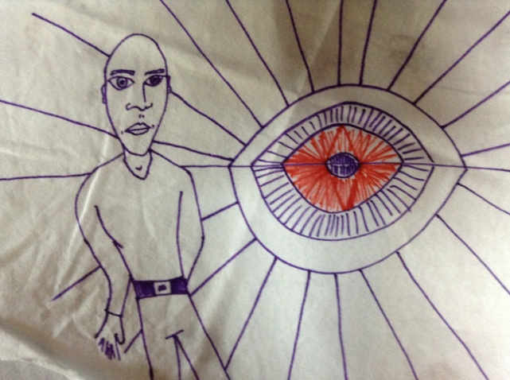
And they did!

Slide 8
Feedback from Meetings
Feedback from Town Halls, Focus Groups, Advisory Groups
→ informed→
Survey Questions

Slide 9
Two Surveys
Survey Data
Community Survey
1943 Respondents
Student
Surveys
8426 Respondents

Slide 10
Community Survey Summary
Total unique survey responses | 1,943
Parent or guardian | 1,404*
ACPS employee | 670*
Community member | 571*
School volunteer | 364*
Alumnus/Alumna of ACPS | 195*
Other (Please specify) | 51*
Student | 28*
*Participant categories are not independent.

Slide 11
Strategic Goals & Instructional Values
By and large, survey participants were aware of the ACPS Strategic Plan (65%) and felt its goals were still relevant.
  Goal 1 – Preparing students for success (89%)
  Goal 3 – Promoting high-quality teaching (84%)
Over 75% of participants valued 16 skills, led by problem solving, communication, reasoning and critical thinking.
  61% valued the ability to speak another language.
Over 90% of participants valued teaching and learning involving critical thinking, problem-solving and “hands-on” learning.
  Less than 70% valued teaching and learning involving projects that connect to the community or that provide more choices for students.
© 2013 K12 Insight

Slide 12
Two-thirds of Survey Participants Knew the Plan
A majority of participants were somewhat familiar with the ACPS Strategic Plan.

Slide 13
Our Strategic Goals
Goal 1 | Prepare all students to succeed as members of a global community and in a global economy.
Goal 2 | Eliminate the Achievement Gap.
Goal 3 | Recruit, retain and develop a diverse cadre of the highest quality teaching personnel, staff and administrators.
Goal 4 | Achieve recognition as a world-class educational system.
Goal 5 | Establish efficient systems for development, allocation and alignment of resources to support the Division’s vision, mission and goals.
© 2013 K12 Insight

Slide 14
Participants Felt
Goals 1 and 3 Still Apply
The greatest share of participants in the online survey said that Goals 1 and 3 still apply.
Note: Multiple answers per participant possible. Percentages added may exceed 100% since a participant may select more than one answer for this question.

Slide 15
Themes: Open-Ended Responses
Other thoughts regarding ACPS goal statements (n=262) Most common theme: Focus on academic excellence and higher student achievement Provide more information and definition to goal statements and less jargon Explore ways to consolidate goal statements Consider including other topics such as safety, rigor, unique student services (i.e., special education, gifted education) as well as social and emotional well-being in goal statements

Slide 16
Participants Valued a Wide Array of Skills
Problem-solving, communication, reasoning and critical thinking skills topped the list of skills participants found important.

Slide 17
Multiculturalism and Multilingualism Lagged Slightly
Although most participants valued having a world view or global outlook, appreciation and sensitivity for diversity and the ability to speak other languages, survey responses indicated they valued these skills the least overall.

Slide 18
Critical Thinking Led Teaching and Learning Values
The greatest share of participants valued teaching and learning that require critical thinking and reasoning in student work, create problem-solving opportunities and offer “hands-on” learning opportunities.

Slide 19
Student Choice and Community Connection Lagged
The smallest share of participants valued teaching and learning that expand global/world focus during instruction, create projects that connect to the community and provide more choices for students.

Slide 20
Participants Supported Teacher Development Most
The greatest share of participants supported teacher development, followed by innovation in classroom and student technologies.
Note: *Item may be more relevant to respondents with high school level affiliation.

Slide 21
Themes from Open-Ended Responses
Participants said…
Expanding ACPS horizons (n=335) Most common theme: Provide more information about a “one-to-one technology initiative for students” Ensure effective and efficient use of technology in the classroom Provide more information about “transforming classroom spaces into innovative learning environments”
Other important skills (n=217) Most common theme: Mathematical skills Fundamental skills Healthy lifestyle skills such as physical fitness, hygiene, body and health awareness
Other important aspects of teaching and learning (n=192) Most common theme: Solving problems and interacting without modern technology Fundamentals – Reading, writing and math Ensuring diverse learning opportunities for students

Slide 22
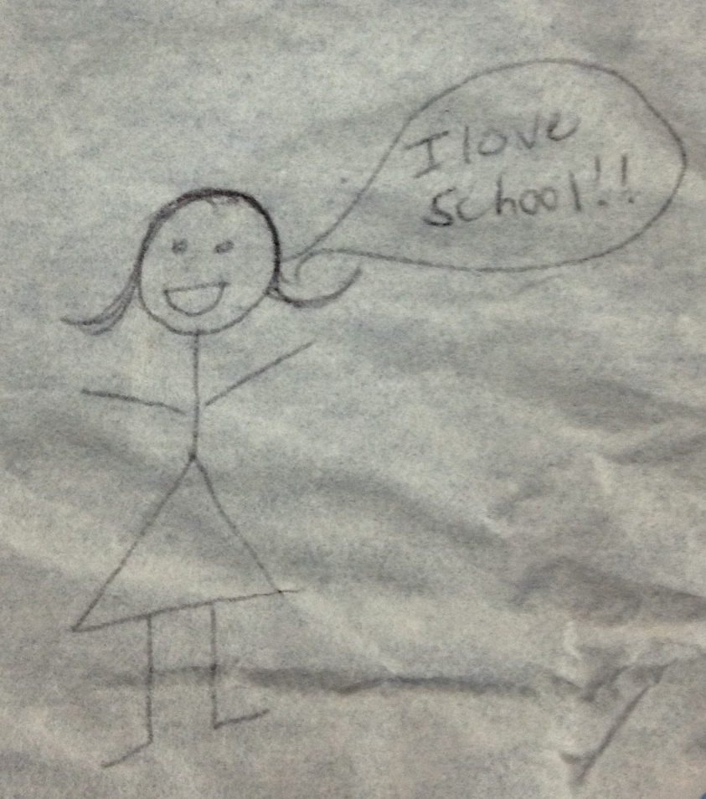
Student Survey Summary
8426
Elementary School,
Middle School, and
High School Students

Slide 23
Skills Necessary to Succeed
Middle School
Skill Areas Ranked by Middle School Students | Rank 1=Most Important 7=Least Important
Communication (using words to speak, read, write, or listen so others understand) | 1
Creativity (making something new or doing things differently) | 2
Collaboration (working with others to create a solution) | 3
Critical thinking (examining what is read or presented and judging accuracy and effect) | 4
Career exploration and real-world work skills | 5
Money management (knowing how to make good choices about spending and saving money) | 6
Appropriate use of technology (knowing what tools to use for a task) | 7

Slide 24
Skills Necessary to Succeed
High School
Skill Areas Ranked by High School Students | Rank 1=Most Important 7=Least Important
Communication (using words to speak, read, write, or listen so others understand) | 1
Critical thinking (examining what is read or presented and judging accuracy and effect) | 2
Creativity (making something new or doing things differently) | 3
Collaboration (working with others to create a solution) | 4
Career exploration and real-world work skills | 5
Money management (knowing how to make good choices about spending and saving money) | 6
Appropriate use of technology (knowing what tools to use for a task) | 7

Slide 25
Lifelong Learning in Schools
Elementary School Students
At school I… | Agree | Not Sure | Disagree
Do research | 77.7% | 19.1% | 3.18%
Explore and express my ideas | 76.6% | 19.9% | 3.4%
Behave appropriately | 81.2% | 16.4% | 2.5%
Am physically active | 85.4% | 12.4% | 2.2%

Slide 26
Lifelong Learning in Schools
Middle School Students
At school I… | Regularly or Sometimes | Regularly | Sometimes | Rarely
Plan and conduct research | 86.1% | 38.8% | 47.3% | 11.8%
Explore and express my ideas | 87.2% | 48.5% | 38.7% | 10.2%
Act ethically and with respect for diversity | 90.4% | 64.0% | 26.4% | 6.7%
Have a physically active lifestyle | 91.5% | 64.9% | 26.6% | 5.7%

Slide 27
Lifelong Learning in Schools
High School Students
At school I… | Regularly or Sometimes | Regularly | Sometimes | Rarely
Plan and conduct research | 80.7% | 38.4% | 42.3% | 15.1%
Explore and express my ideas | 84.5% | 46.7% | 37.8% | 11.0%
Act ethically and with respect for diversity | 88.8% | 64.7% | 24.1% | 6.5%
Have a physically active lifestyle | 84.2% | 56.0% | 28.2% | 10.9%

Slide 28
Learning Opportunities
Middle School Students
 | Regularly or Sometimes | Rarely
When I am working on a task, I know ahead of time what I need to know to succeed with it. | 92.1% | 5.1%
I have the opportunity to solve problems that have more than one right answer. | 88.9% | 8.5%
My learning feels connected to my experiences or what I have learned before. | 88.2% | 8.7%
I have opportunities to share my work with others. | 87.5% | 9.7%
I have meaningful options and choices about my learning work. | 86.7% | 9.9%
I have the opportunity to socialize as a part of my learning. | 83.2% | 14.1%
I feel safe to take risks with my work. | 82.7% | 14.4%
My learning experiences are unusual or unexpected. | 66.6% | 30.3%

Slide 29
Learning Opportunities
High School Students
 | Regularly or Sometimes | Rarely
When I am working on a task, I know ahead of time what I need to know to succeed with it. | 88.0% | 5.8%
I have the opportunity to solve problems that have more than one right answer. | 85.7% | 8.1%
I have opportunities to share my work with others. | 85.5% | 8.1%
I have the opportunity to socialize as a part of my learning. | 84.4% | 8.9%
My learning feels connected to my experiences or what I have learned before. | 84.3% | 9.1%
I have meaningful options and choices about my learning work. | 83.0% | 10.2%
I feel safe to take risks with my work. | 81.5% | 12.2%
My learning experiences are unusual or unexpected. | 69.1% | 24.3%

Slide 30
Key Milestones
Following Data Collection
Review Process Status Update to School Board
April 25, 2013
Summary and Validation Meeting
April 22, 2013
Quality Council Review of Post Survey Focus Group Data
April 26, 2013
Report to Superintendent and Cabinet at Retreat
May 21, 2013
Report to School Board at Retreat
June 3, 2013

Slide 31
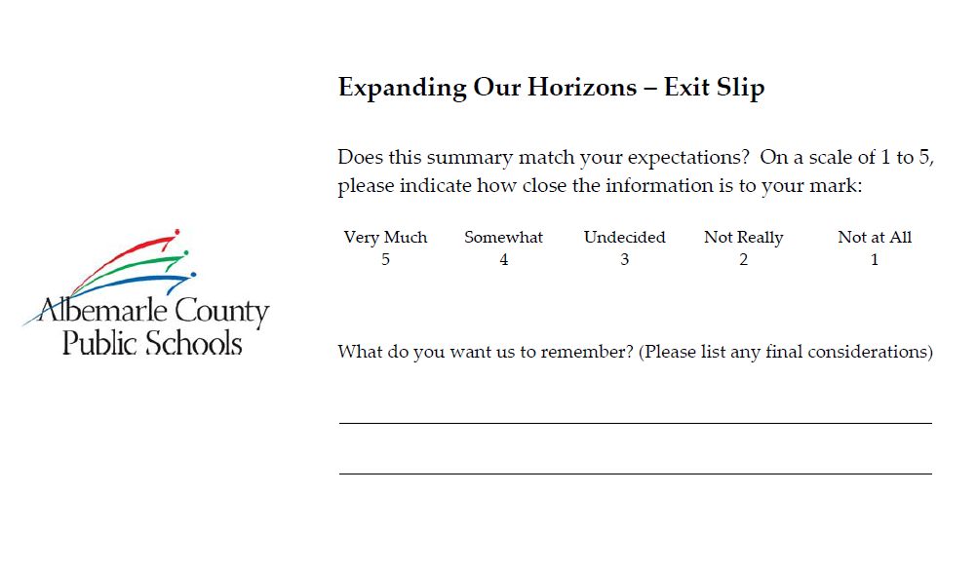
Exit Slip – Summary & Validation Meeting on April 22nd

Slide 32
Exit Slip – Summary & Validation Meeting on April 22nd

Slide 33
Supporting Data
Supporting data for this presentation can be found in the accompanying Appendices as follows:
  Appendix 1 – Community Survey Data
  Appendix 2 – Student Survey Data
  Appendix 3a & 3b – Focus Group comments gathered after data had been sent to K12 Insight as well as comments from Student Council
  Appendix 4 – Exit Slips from Summary and Validation Meeting
  Appendix 5 – “Plain English” Vision and Mission

